Slide 1
Who Is Sequoia
Employee owned world class IT professional services firm that rewards growth and positive results
Leading provider of high-end IT, engineering and professional services
Customers:
Intelligence Community
Homeland Security & Defense
Civilian & Justice
Emerging Technology
Solutions:
AWS/C2S Development/Migration
Big Data Development
Cyber Security
Data Science & Analytics
Founded in 2012; built on uncompromising commitment to our customers and employees
Strong Leadership Team driven by entrepreneurial creativity and focused on client relationships, service and satisfaction
Venture Arm Launched in 2015 - Sequoia Apps
Startup Accelerator that provides coaching, mentoring and initial seed funding

Slide 2


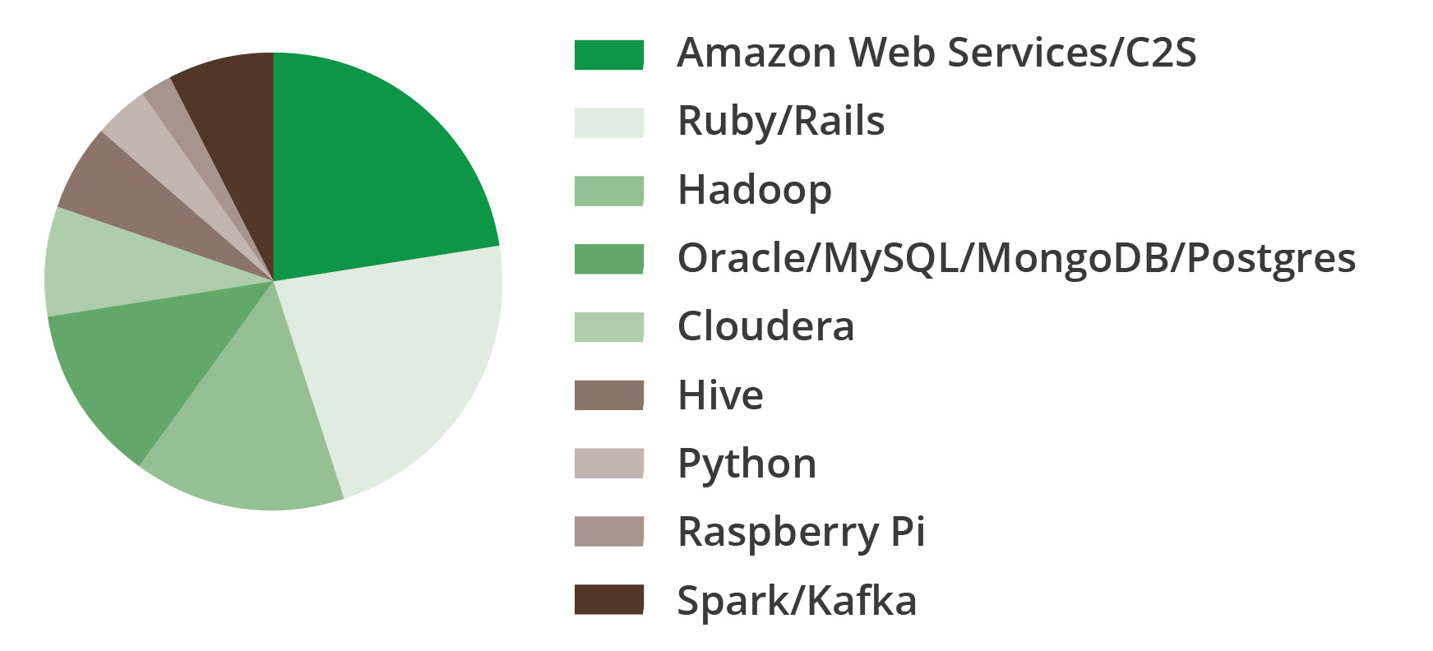
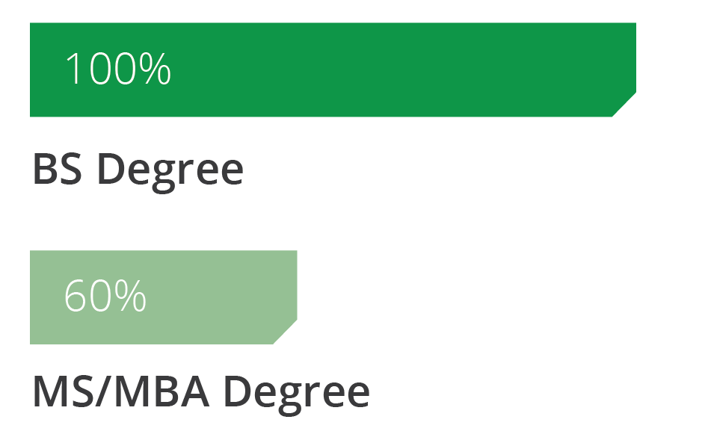
Sequoia By The Numbers
Expertise
Years of Experience
Technologies
Education

Slide 3
AWS Past Performance
Sequoia has established itself as a leader in assisting the national security sector with strategy, architecture, migration and development solutions in the AWS cloud
Experience w/ AWS support includes the US Intelligence Community and DHS
AWS past performance examples:
Application Migration Support
New Application Development
System Architecture Design and Rollout
Managed Services (DevOps)
Sequoia is a recognized Amazon Consulting Partner
Detailed Past Performance Upon Request

Slide 4
For More Information
Contact Us At:
11180 Sunrise Valley Drive, Suite 110 Reston VA
571-267-7945
jobs@sequoiainc.com
Follow Us At:
Website: http://sequoiainc.com
Blog: http://blogs.sequoiainc.com/
Sequoia Apps: http://www.sequoia-apps.com/
Twitter: https://twitter.com/sequoiainc
Facebook: https://www.facebook.com/sequoiainc
LinkedIn: https://www.linkedin.com/company/sequoia-holdings-inc

